Slide 1
Lecture 07- Roadmap
Transmission Impairments
Attenuation,
Distortion,
Noise and its Types
Channel Capacity,
  Nyquist and Shannon Capacity Formula
Data Rate Limits and Performance

Slide 2
Transmission Impairments
Signal received may differ from signal transmitted
Signals travel through transmission media, which are not perfect. The imperfection cause impairment in the signal.
Analog Signals- degradation of signal quality
Digital Signals - bit errors
Most significant Impairments are:
  Attenuation
  Delay distortion
  Noise

Slide 3
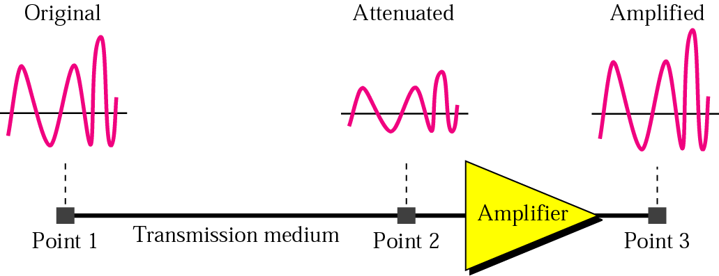
Attenuation
Attenuation means loss of energy. When a signal , simple or composite , travels through a medium, it loses some of its energy so that it can overcome the resistance of the medium.
Attenuation is an increasing function of frequency

Slide 4
Decibel
The decibel is a measure of relative strength of two signal levels:
  NdB = 10 log P2/P1
  Where,
  NdB = number of decibels
  P1 = input power level
  P2 = output power level
  Log 10 = logarithm to base 10
Note that the decibel is negative if a signal is attenuated and positive if a signal is amplified.

Slide 5
Example
Suppose a signal travels through a transmission medium and its power is reduced to one-half.
Solution:
This means that P2 = 1/2 PI'
In this case, the attenuation (loss of power) can be calculated as
10 Log P2/P1
10 Log 0.5 P1/P1
10 Log 0.5 = 10(-0.3) = -3 dB
A loss of 3 dB (-3 dB) is equivalent to losing one-half the power.

Slide 6
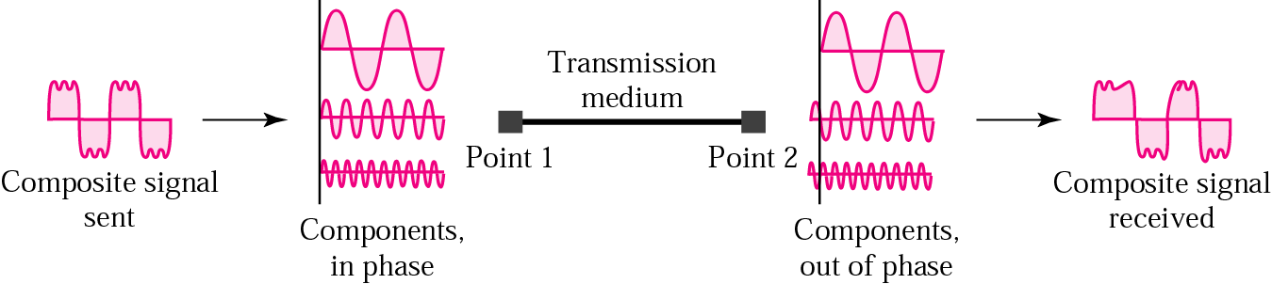
Delay Distortion
Distortion means that the signal changes its form or shape. Distortion occurs in a composite signal, made of different frequencies some of those frequency components arrive at destination sooner than others.
Only in guided media
Equalizing techniques can be used to overcome it.

Slide 7
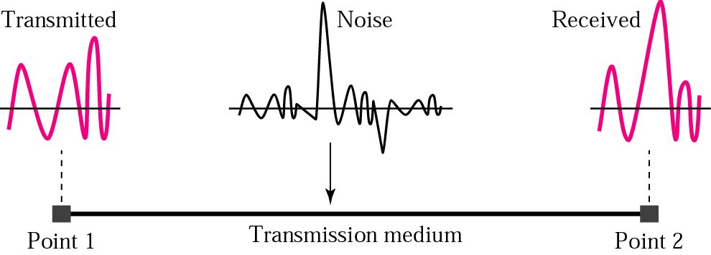
Noise
Additional signals inserted between transmitter and receiver
Several types of noise are exists such as
thermal noise, Induced noise, Crosstalk, and Impulse noise

Slide 8
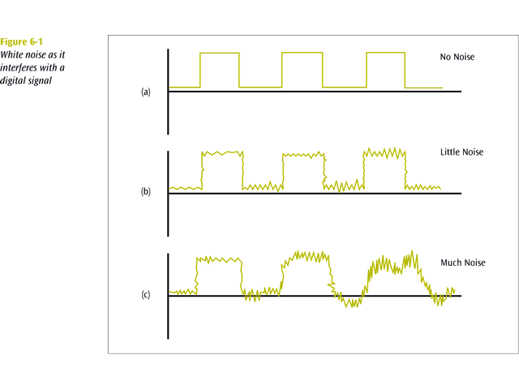
Thermal Noise
  Due to thermal agitation of electrons
  Uniformly distributed
  White noise

Slide 9
Induced Noise
Induced noise comes from sources such as motors and appliance.
These devices act as sending antenna and the transmission medium act as the receiving antenna.

Slide 10
Cross Talk
Crosstalk
  A signal from one line is picked up by another
  Occur due to the electrical coupling between near by twisted pair cable or unwanted signals picked by microwave antennas
Unwanted coupling between two different signal paths.
For example, hearing another conversation while talking on the telephone.
Relatively constant and can be reduced with proper measures.

Slide 11
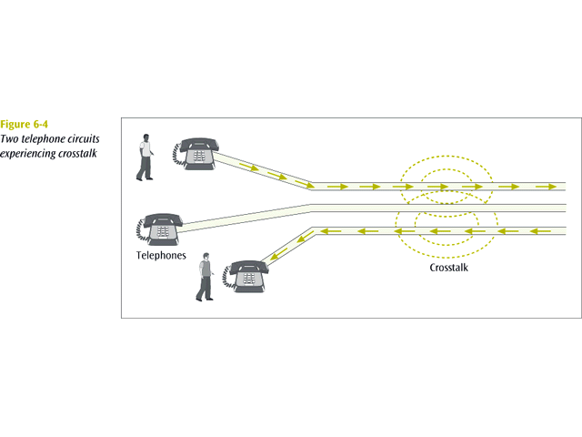
Cross Talk

Slide 12
Impulse Noise
Impulse
  Irregular pulses or spikes
  e.g. External electromagnetic interference
  Short duration, High amplitude
Difficult to remove from an analog signal because it may be hard to distinguish from the original signal.
Impulse noise can damage more bits if the bits are closer together (transmitted at a faster rate).

Slide 13
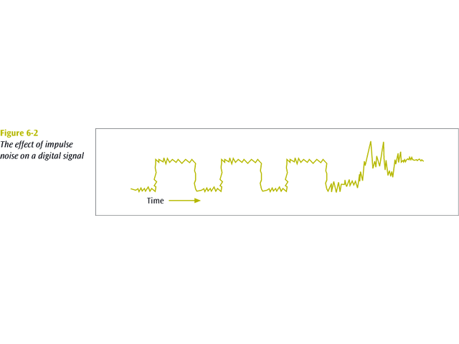
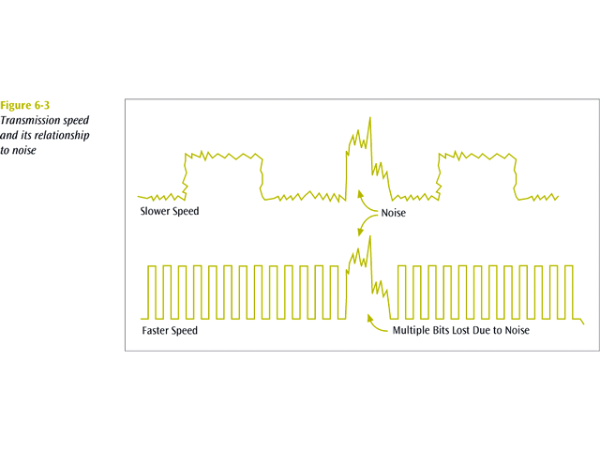

Slide 14

Two cases of SNR: a high SNR and a low SNR

Slide 15
SNR and SNRdB
The signal-to-noise ratio is defined as
SNR=average signal power/average noise power
Because SNR is the ratio of two powers, it is often described in decibel units, so
SNRdB, defined as 10 Log SNR

Slide 16
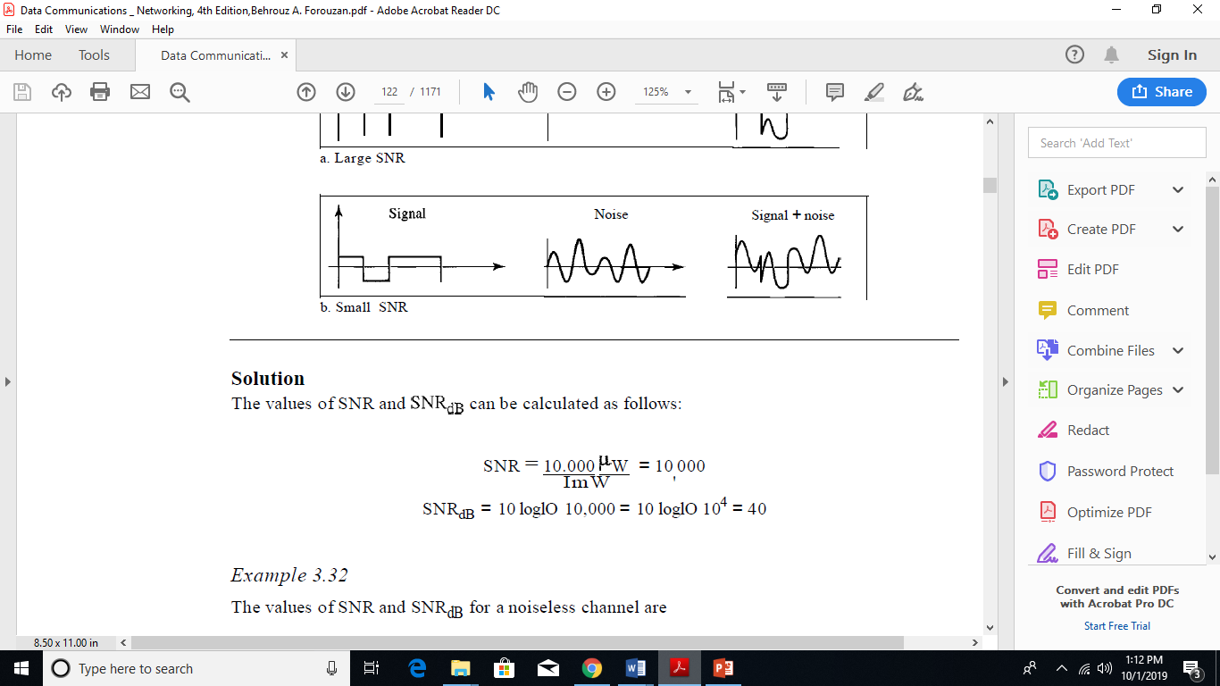
Example 1
The power of a signal is 10 mW and the power of the noise is 1 /lW; what are the values of SNR
and SNRdB?
Solution:

Slide 17

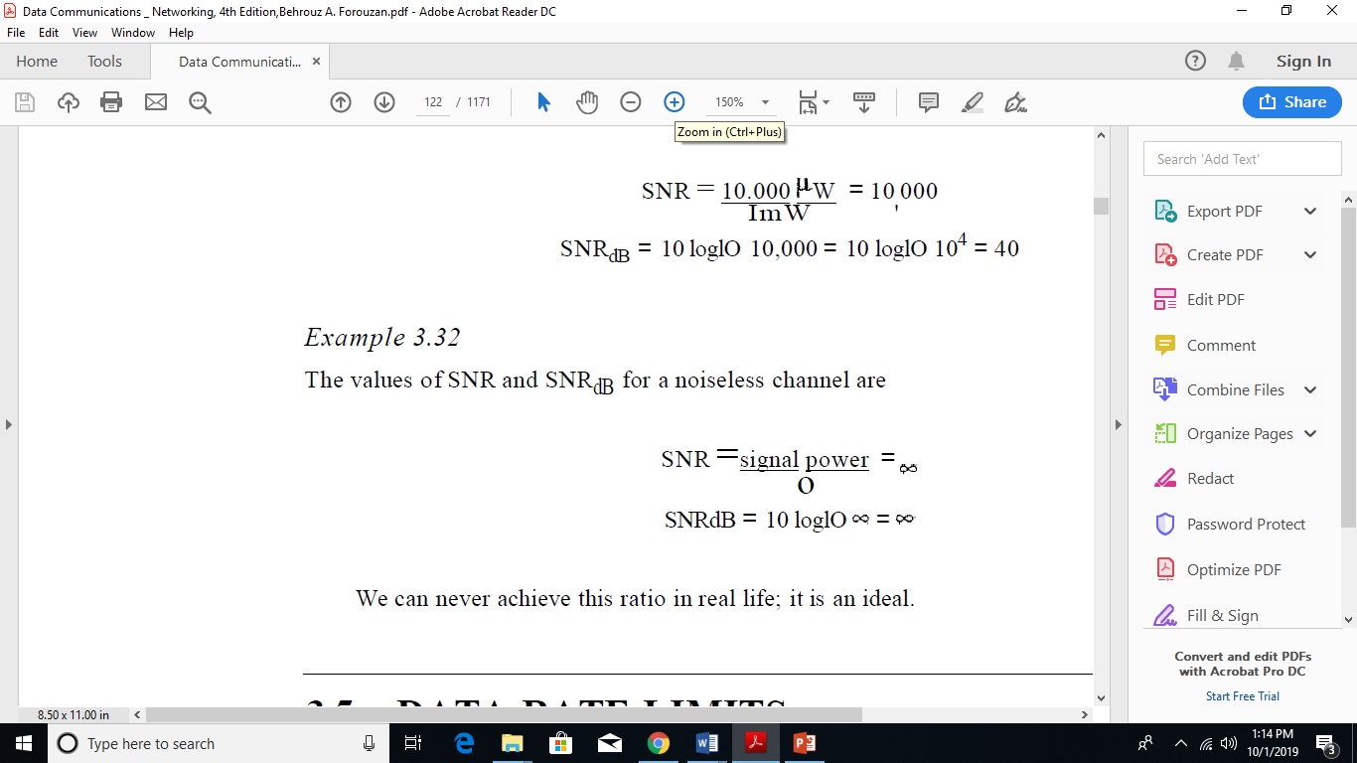
Example 2

Slide 18
Channel Capacity
Channel capacity is the maximum rate at which the data can be transmitted over a given communication path, or channel, under given conditions.
Data rate
  In bits per second
  Rate at which data can be communicated
Bandwidth
  In cycles per second of Hertz
  Constrained by transmitter and medium

Slide 19
Data Rate Limits
Data Rate depends on three factors.
The bandwidth available
The level of the signals we use
The quality of the channel (the level of noise)

Slide 20
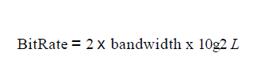
Noiseless Channel:Nyquist Bit Rate
It can be defined as
  Where, M = number of discrete voltage levels
  L = number of signal levels used to represent data
  B = Bandwidth of the Channel
  Note: Increasing the levels of a signal may reduce the reliability of the system.

Slide 21
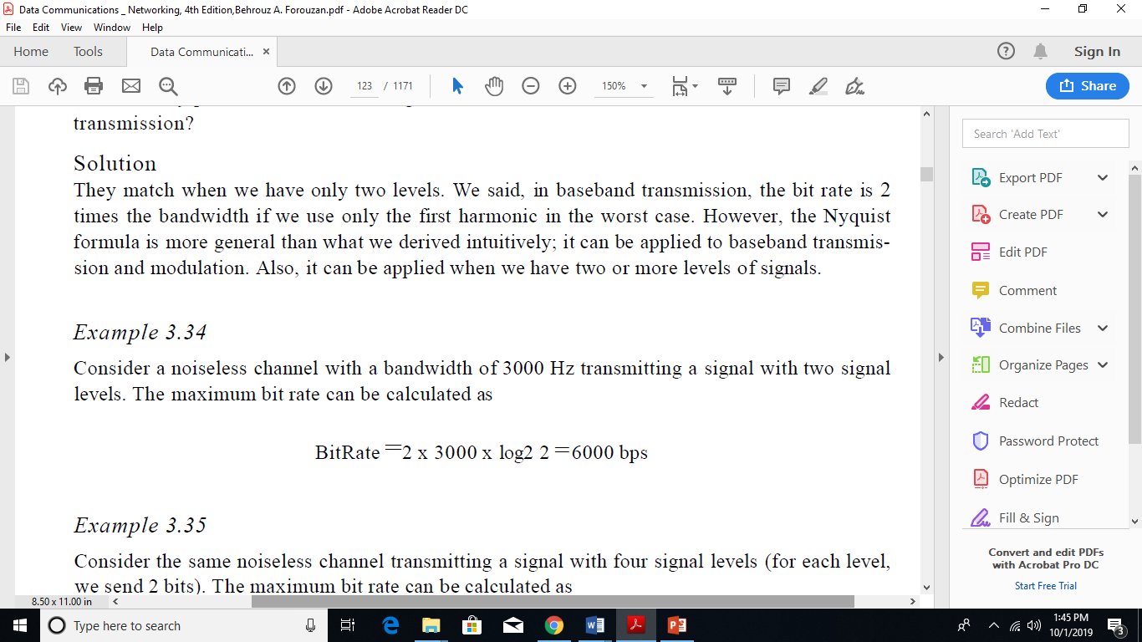
Example 1

Slide 22
Noisy Channel: Shannon Capacity Formula
At a given noise level, the higher the data rate, the higher the error rate.
The Shannon’s result is that the maximum error free channel capacity is:
  C = B log2 (1+SNR)
  Where, C = capacity of channel in bits per second
  B = Bandwidth of the signal in Hertz
  SNR = Signal to Noise Ratio
(SNR)dB = 10 log10 (signal power/noise)
High SNR means a high quality signal and low number of required intermediate repeaters
As bandwidth increases, SNR decreases because more noise will be admitted to the system.

Slide 23
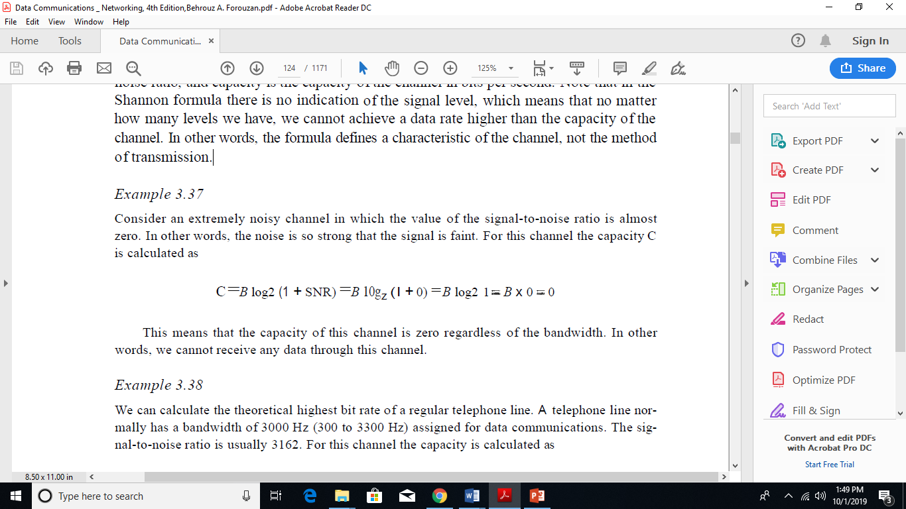
Example 1

Slide 24
PERFORMANCE
One important issue in networking is the performance of the network—how good is it? We discuss quality of service, an overall measurement of network performance, in greater detail latter on in the course.
In this section, we introduce terms the following terms
Bandwidth
Throughput
Latency (Delay)
Bandwidth-Delay Product

Slide 25
Bandwidth
In networking, we use the term bandwidth in two contexts.
The first, bandwidth in hertz, refers to the range of frequencies in a composite signal or the range of
frequencies that a channel can pass.
The second, bandwidth in bits per second, refers to the speed of bit transmission in a channel or link.

Slide 26

Throughput
A network with bandwidth of 10 Mbps can pass only an average of 12,000 frames per minute with each frame carrying an average of 10,000 bits. What is the throughput of this network?
Solution
We can calculate the throughput as
The throughput is almost one-fifth of the bandwidth in this case

Slide 27
Latency
Latency = Propagation time +
transmission time +queuing time + processing delay

Slide 28
Propagation time
Propagation time measures the time required for a bit to travel from the source to the destination. The propagation time is calculated by dividing the distance by the propagation speed.
Propagation time = Distance/Propagation speed

Slide 29
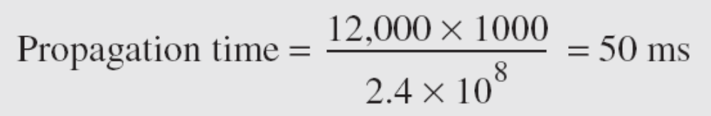
Propagation time
What is the propagation time if the distance between the two points is 12,000 km? Assume the propagation speed to be 2.4 × 108 m/s in cable.
Solution
We can calculate the propagation time as
The example shows that a bit can go over the Atlantic Ocean in only 50 ms if there is a direct cable between the source and the destination.

Slide 30
Transmission Time
we don't send just 1 bit, we send a message.
There is a time between the first bit leaving the sender and the last bit arriving at the receiver.
The time required for transmission of a message depends on the size of the message and the bandwidth of the channel.
Transmission time =Message size/Bandwidth

Slide 31
Queuing Time
The third component in latency is the queuing time,
the time needed for each intermediate
or end device to hold the message before it can be processed.
The queuing time is not a fixed factor; it changes with the load imposed on the network.

Slide 32

Filling the link with bits for case 1

Slide 33

Filling the link with bits in case 2
We can think about the link between two points as a pipe. The cross section of the pipe represents the bandwidth, and the length of the pipe represents the delay. We can say the volume of the pipe defines the bandwidth-delay product, as shown in Figure 3.33

Slide 34
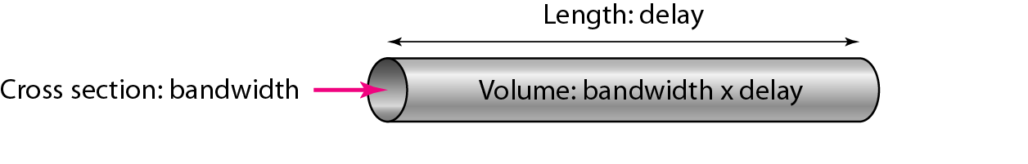
Concept of bandwidth-delay product
The bandwidth-delay product defines the number of bits that can fill the link.

